Slide 1
UNIT-IV
File Operations

Slide 2
Reading config files in python
Config files help creating the initial settings for any project, they help avoiding the hardcoded data.
if you migrate your server to a new host and suddenly your application stops working, now you have to go through your code and search/replace IP address of host at all the places. Config file comes to the rescue in such situation.
You define the IP address key in config file and use it throughout your code. Later when you want to change any attribute, just change it in the config file.
In Python we have configparser module which can help us with creation of config files (.ini format).

Slide 3
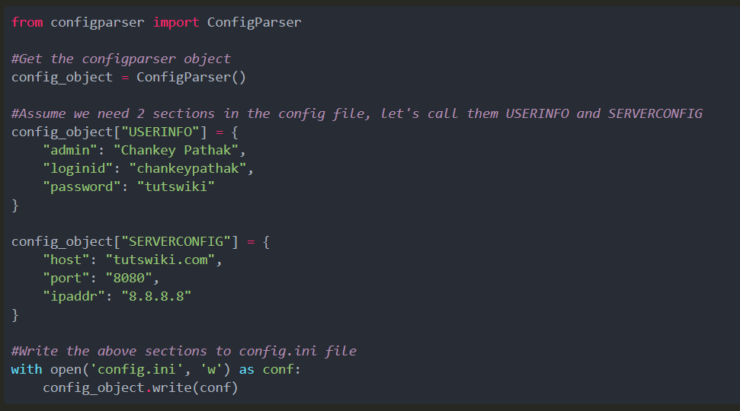
Creating a config file

Slide 4
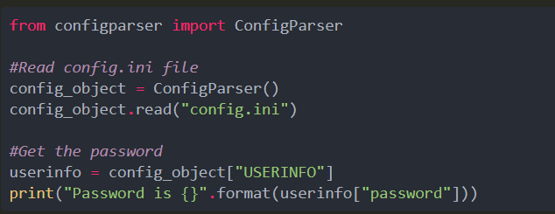
Reading a key from config file

Slide 5
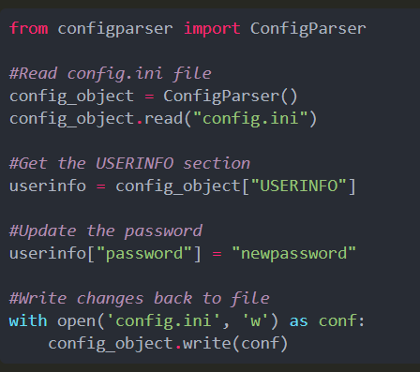
Updating a key in config file

Slide 6
Writing log files in python
Logging is a very useful tool for a programmer.
It can help you develop a better understanding of the flow of a program and discover scenarios that you might not even have thought of while developing.
They can store information, like which user or IP accessed the application.
If an error occurs, then they can provide more insights
Not only debug errors easily but also use the data to analyze the performance of the application
Python provides a logging system as a part of its standard library
The logging module in Python is a ready-to-use and powerful module

Slide 7
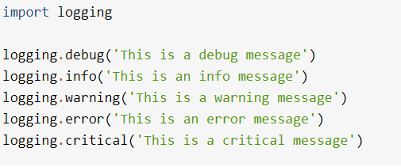

Slide 8
Text Files
Using a text editor such as Notepad or TextEdit, you can create, view, and save data in a text file
Python programs can output data to a text file
The data in a text file can be viewed as characters, words, numbers, or lines of text, depending on the text file’s format and on the purposes for which the data are used.

Slide 9
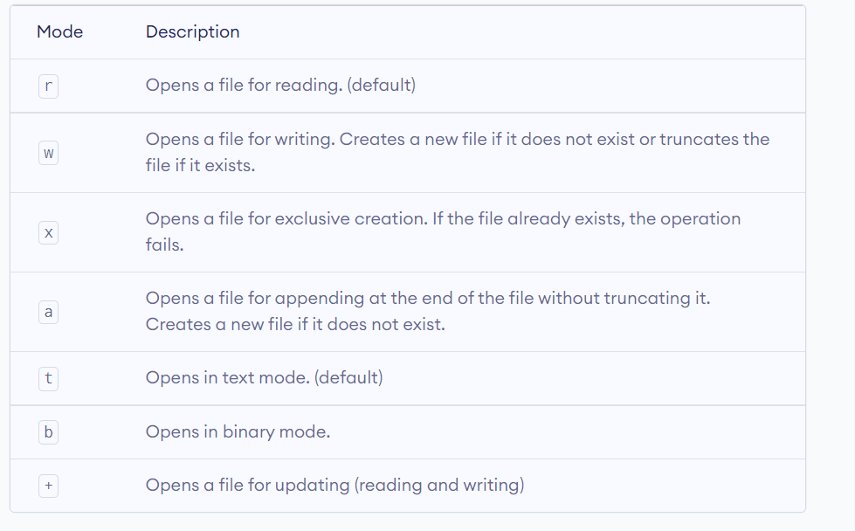
Modes of file open

Slide 10
Open & closing file
f = open("test.txt") # equivalent to 'r' or 'rt'
f = open("test.txt",'w') # write in text mode
f = open("img.bmp",'r+b') # read and write in binary mode
f = open("test.txt", encoding = 'utf-8')
# perform file operations
f.close()

Slide 11
Writing Text to a File
Data can be output to a text file using a file object.
Python’s open function, which expects a file name and a mode string as arguments, opens a connection to the file on disk and returns a file object.
The mode string is 'r' for input files and 'w' for output files.
Thus, the following code opens a file object on a file named myfile.txt for output
>>> f = open("myfile.txt", ‘w’)
>>> f.write("First line.\nSecond line.\n“)
>>> f.close()

Slide 12
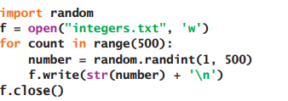
Writing Numbers to a File

Slide 13
Reading Text from a File
You open a file for input in a similar manner to opening a file for output.
The only thing that changes is the mode string, which, in the case of opening a file for input, is 'r’.
However, if a file with that name is not accessible, Python raises an error.
Here is the code for opening myfile.txt for input
>>> f = open("myfile.txt", ‘r’)
>>> text = f.read()
>>> text
'First line.\nSecond line.\n’
>>> print(text)
First line.
Second line.

Slide 14
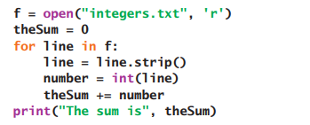
Reading Numbers from a File

Slide 15
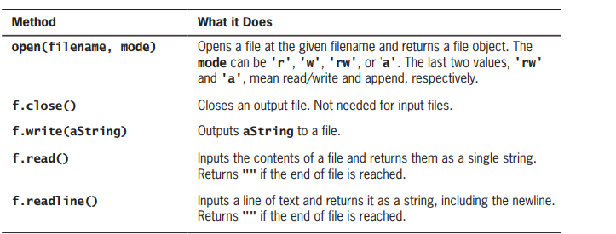

Slide 16
Manipulating File pointer
We can change our current file cursor (position) using the seek() method. Similarly, the tell() method returns our current position (in number of bytes).
>>> f.tell() # get the current file position
56
>>> f.seek(0) # bring file cursor to initial position
0
>>> print(f.read()) # read the entire file
This is my first file
This file
contains three lines

Slide 17
readline():
we can use the readline() method to read individual lines of a file. This method reads a file till the newline, including the newline character.
>>> f.readline()
'This is my first file\n'
>>> f.readline()
'This file\n'
>>> f.readline()
'contains three lines\n'

Slide 18
readlines:
>>> f.readlines()
['This is my first file\n', 'This file\n', 'contains three lines\n']

Slide 19
